Slide 1

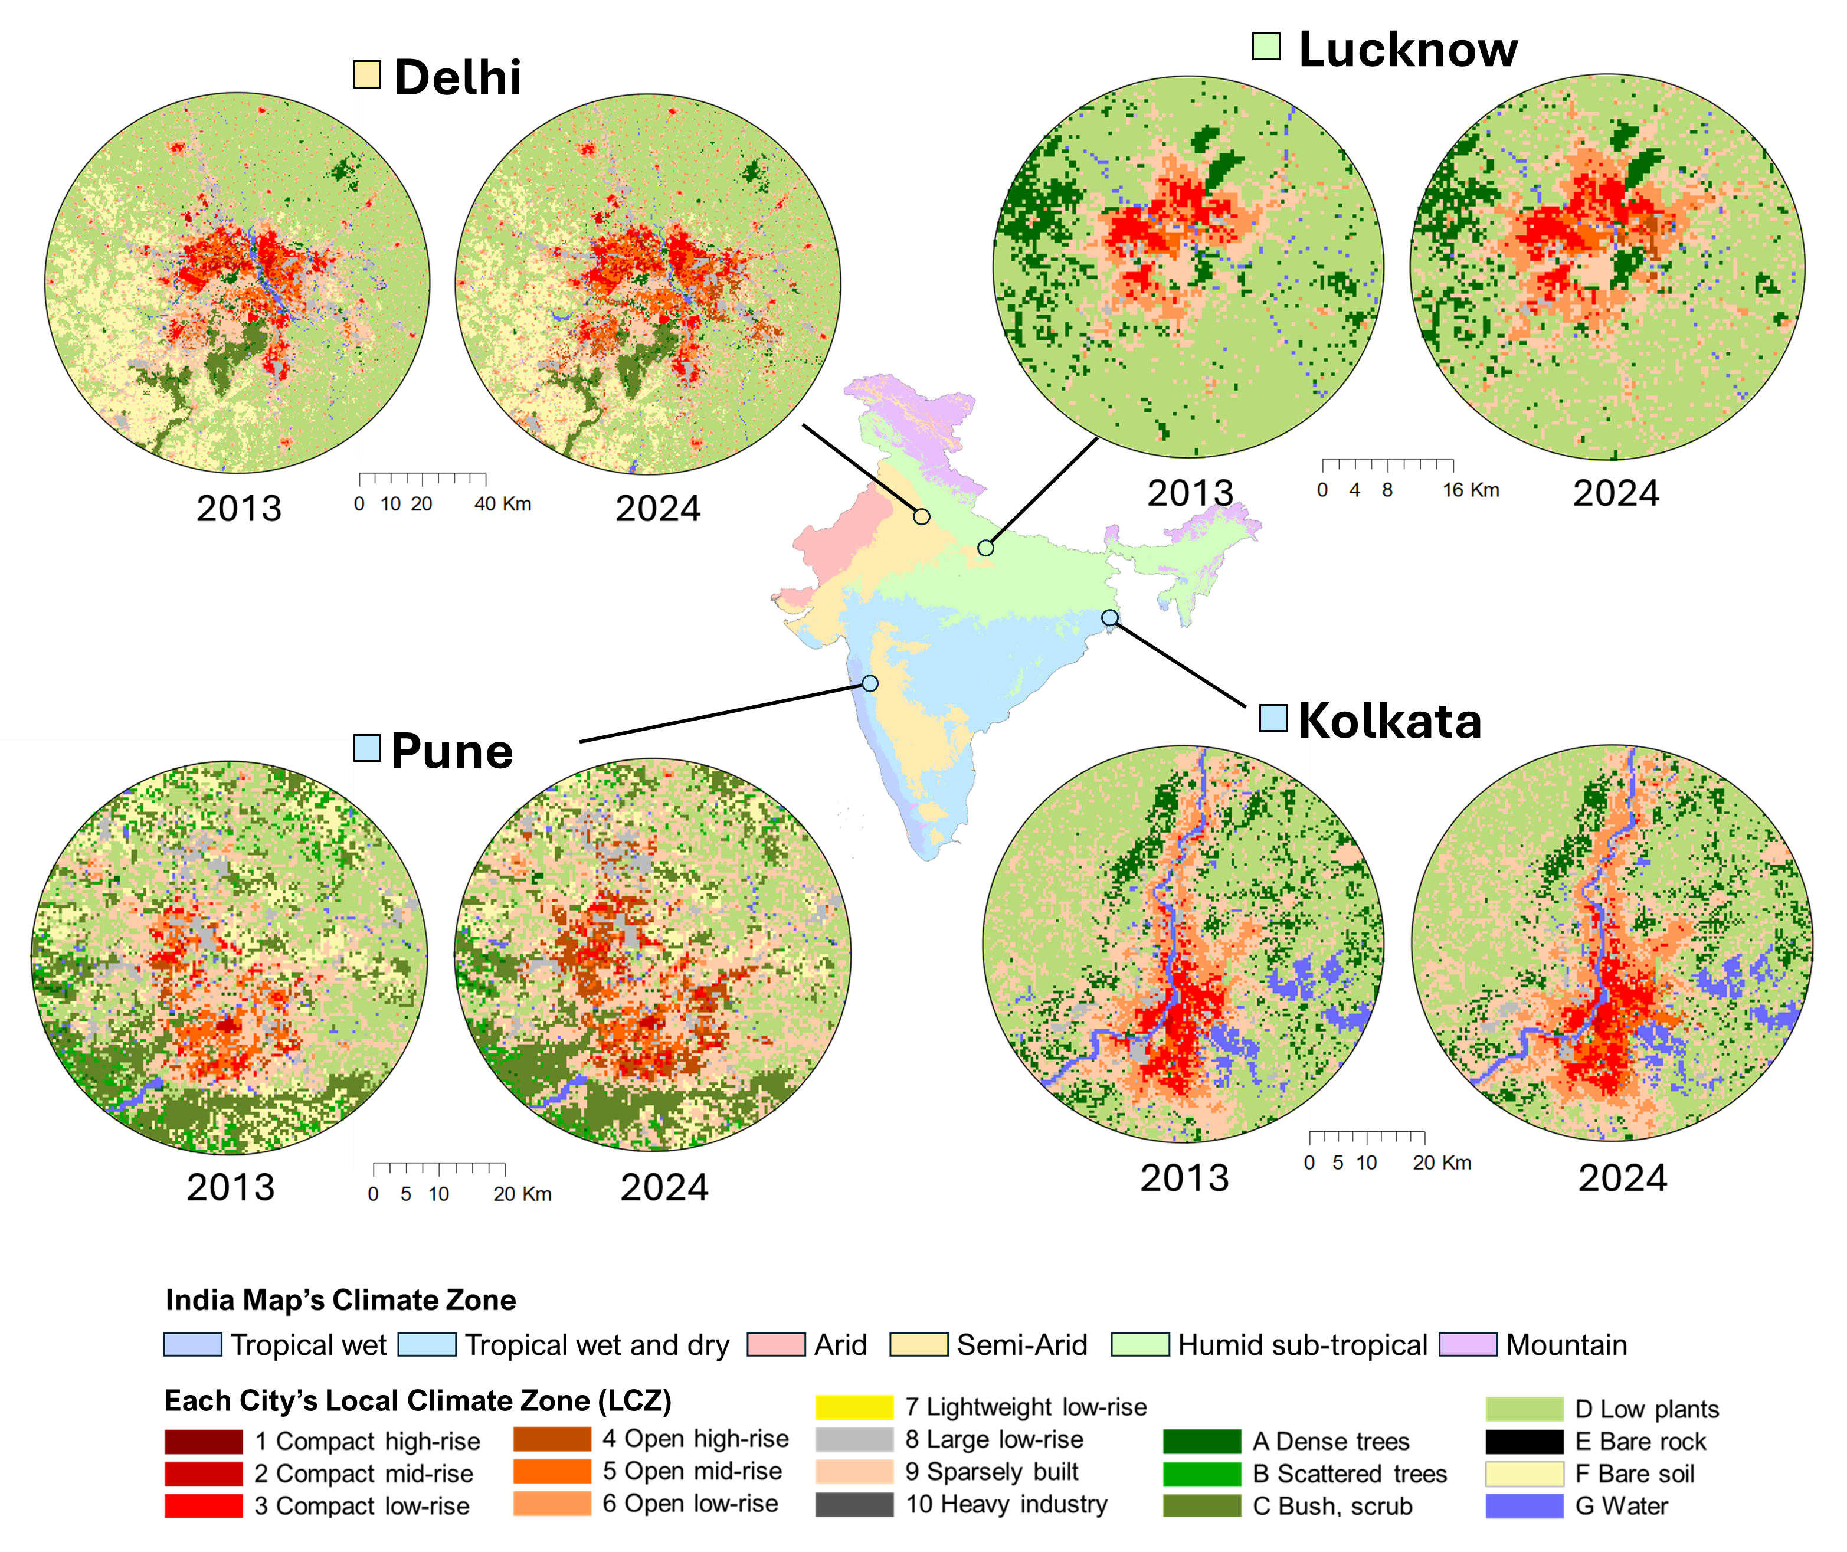
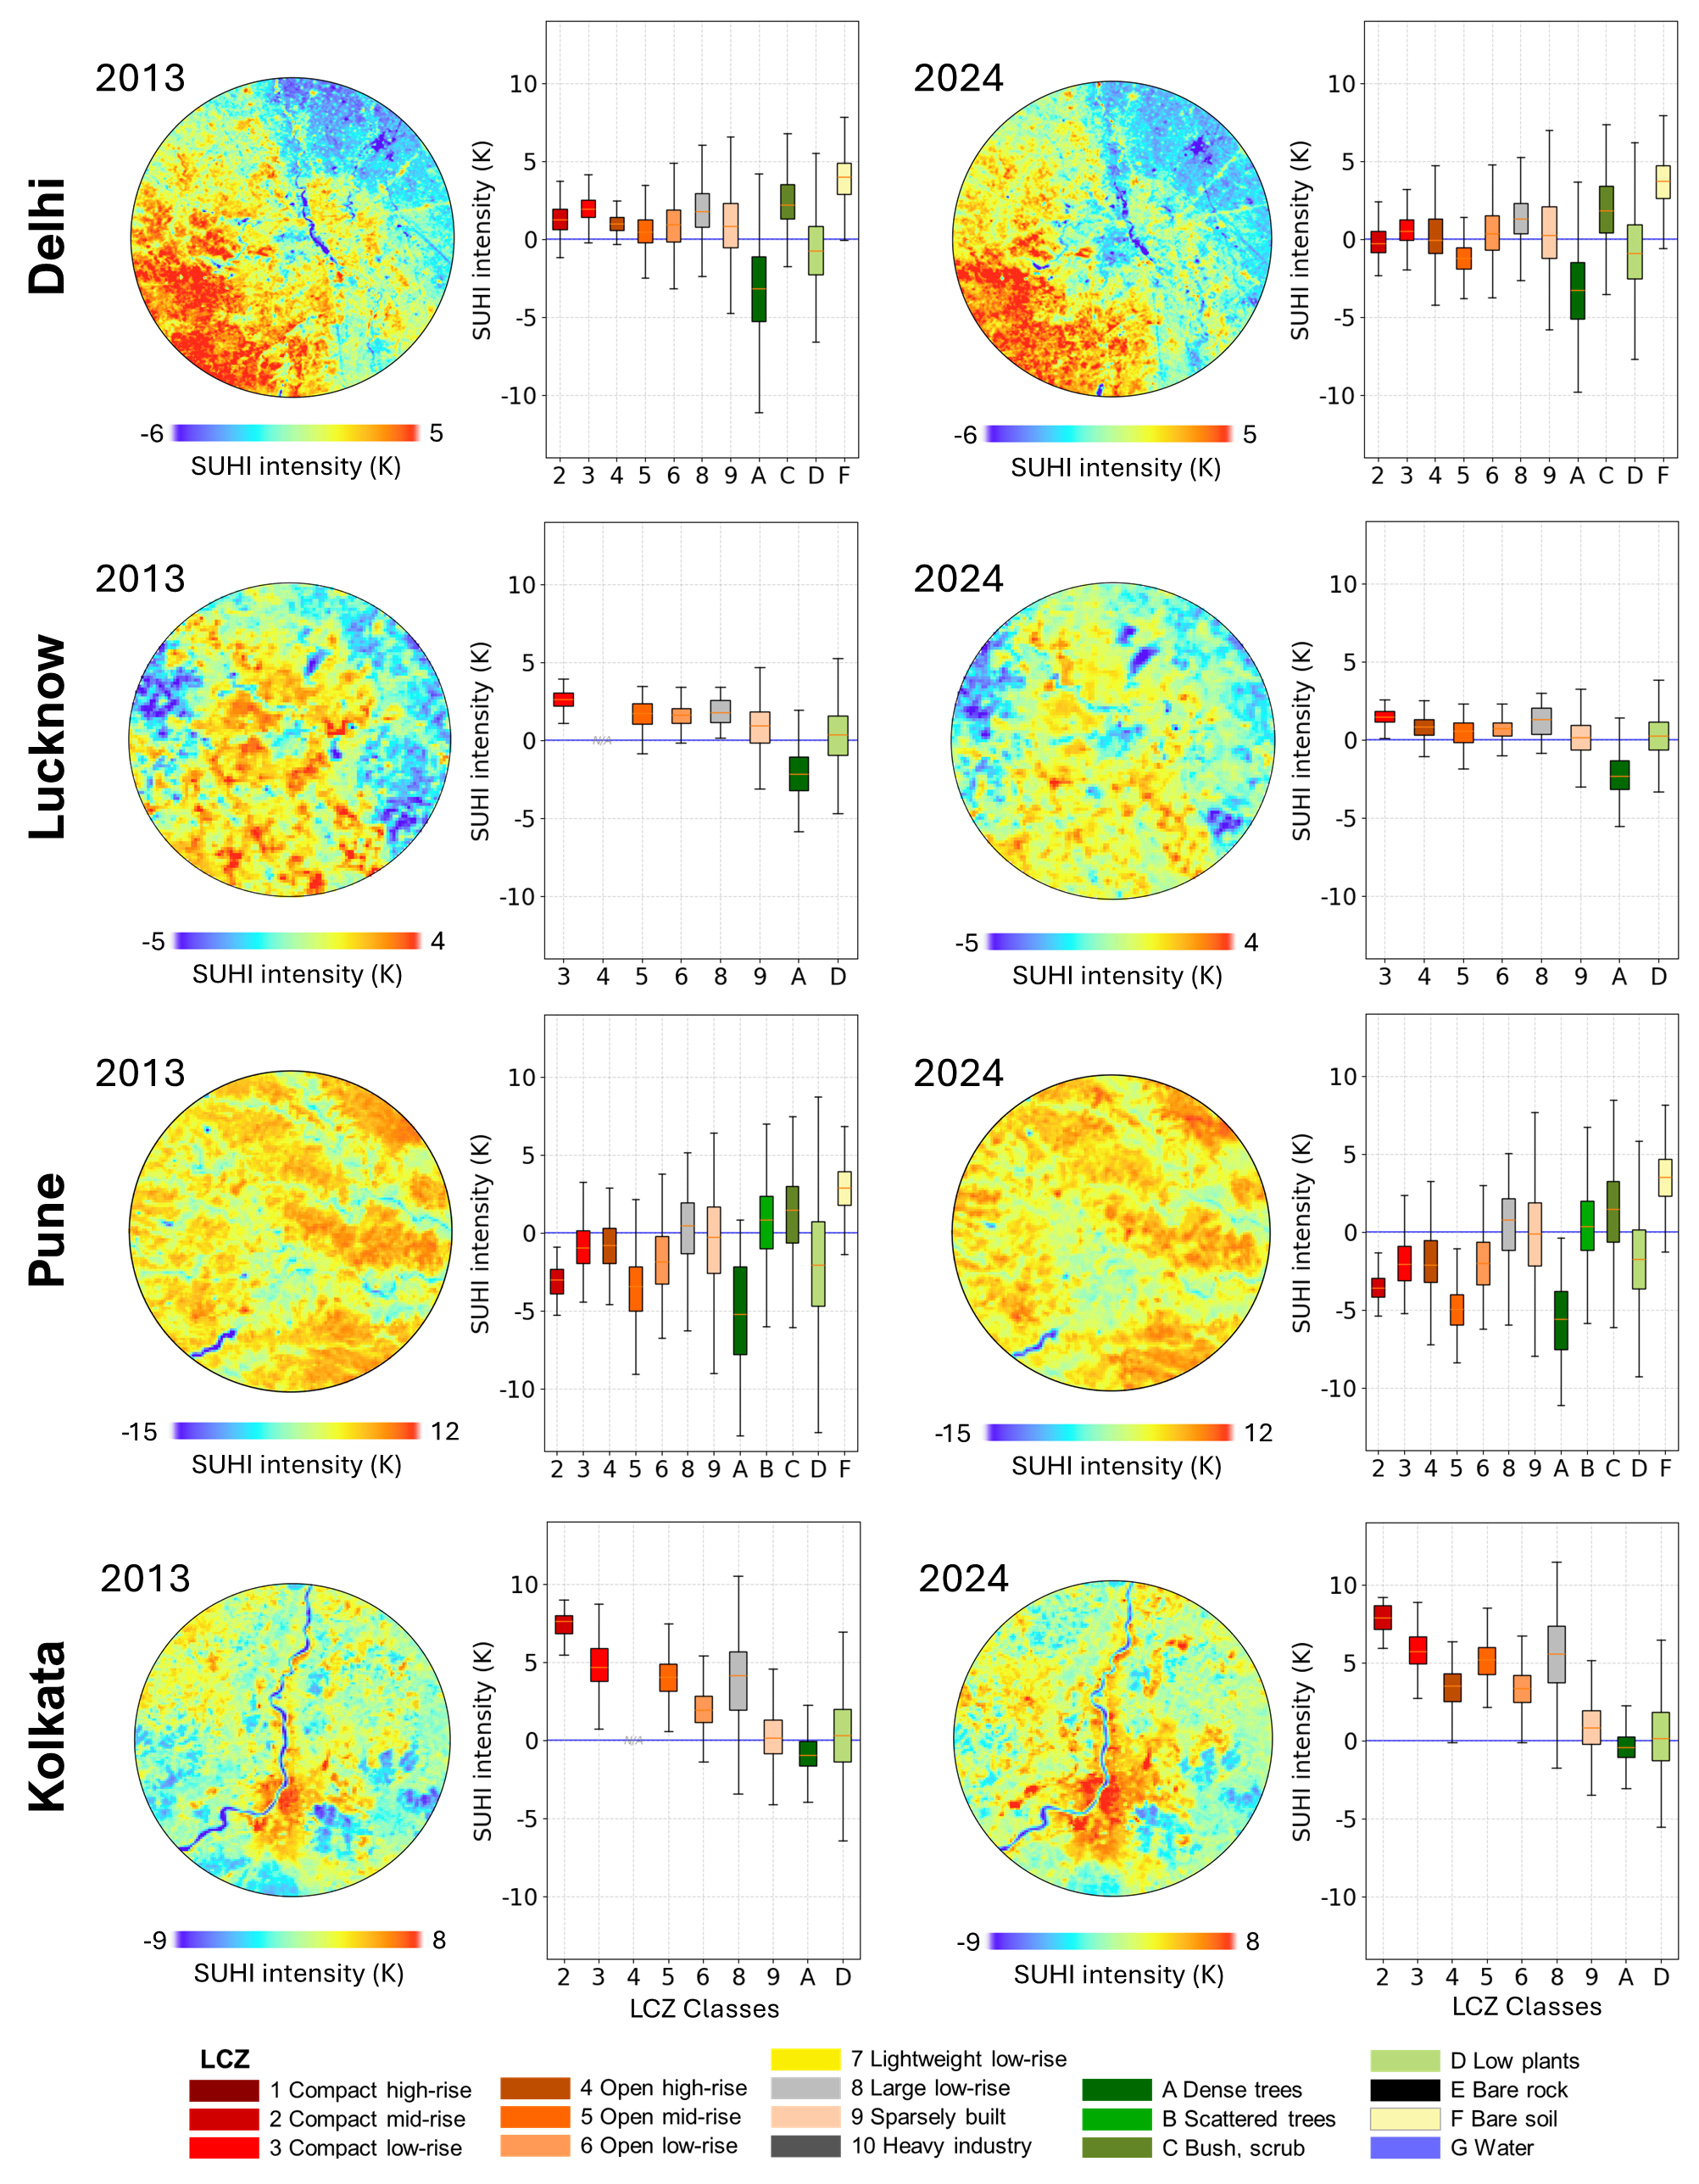
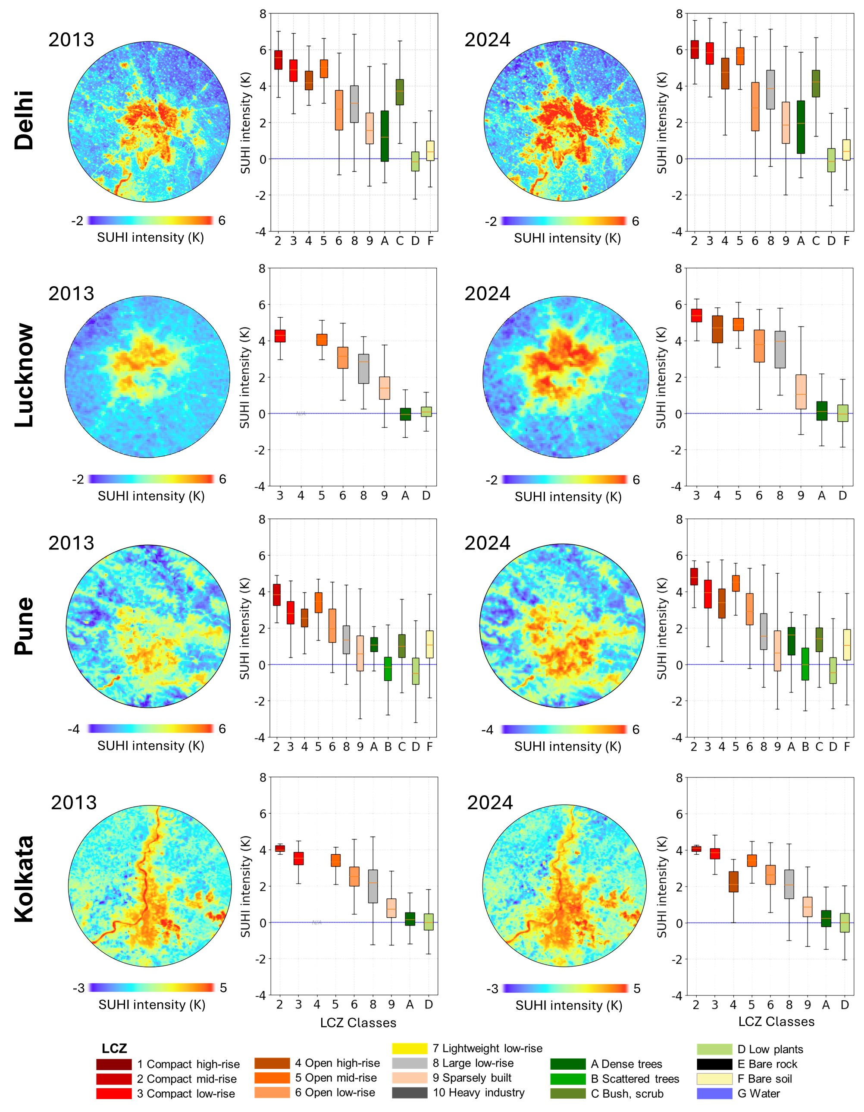
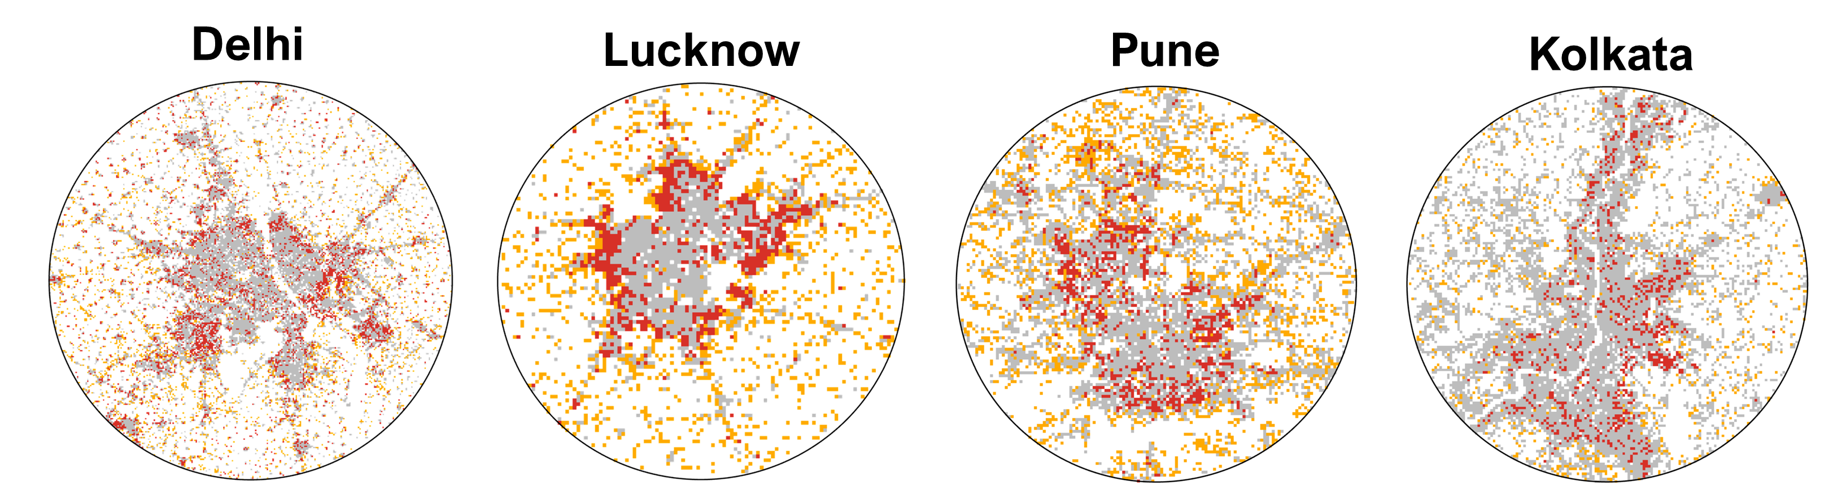
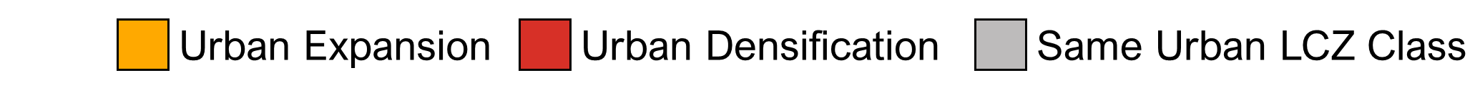
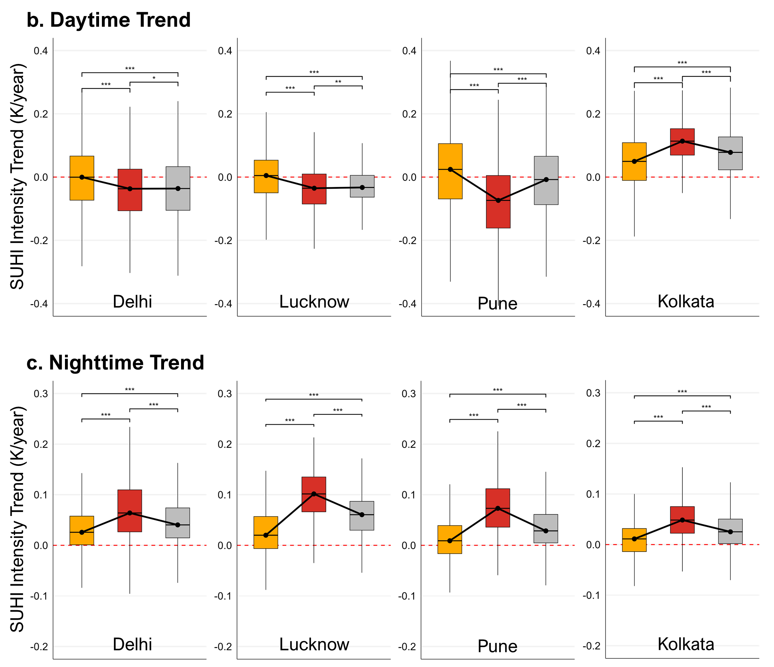
National Aeronautics and Space Administration
Postdoc Research
Quantifying the impacts of urban densification on the urban heat island effect in Indian cities
Authors: Cheolhee Yoo, JPL Postdoctoral Fellow (329G)
Glynn Hulley (329G), Anamika Shreevastava (New York University), Ronita Bardhan (University of Cambridge)
Background
India’s cities are rapidly transforming through both outward expansion and densification, altering urban form and intensifying the urban heat island (UHI) effect. Traditional urban maps capture expansion but often overlook densification. The Local Climate Zone (LCZ) framework, combined with daily VIIRS land surface temperature (375 m), enables new insights into how different urban growth modes influence UHI patterns.
Objective
This study maps LCZ changes between 2013 and 2024 in four Indian cities—Delhi, Lucknow, Pune, and Kolkata (Figure 1)—and integrates them with VIIRS LST to assess the relative impacts of expansion and densification on daytime and nighttime UHI intensity.
Approach and Results
We developed LCZ-based urban trajectory maps for Delhi, Lucknow, Pune, and Kolkata, distinguishing expansion, densification, and stable classes between 2013 and 2024. These trajectories were integrated with VIIRS LST to evaluate changes in daytime and nighttime SUHI intensity (Figures 2 and3). At night, urban densification consistently produced the strongest SUHI intensification across all four cities, followed by stable LCZ classes, while urban expansion showed comparatively weaker warming (Figure 4).
Figure 1: Locations of the four study cities—Delhi, Lucknow, Pune, and Kolkata—and their Local Climate Zone (LCZ) maps for 2013 and 2024. The background map shows Köppen climate zones for each city (Delhi: semi-arid; Lucknow: humid subtropical; Pune and Kolkata: tropical wet–dry).
a.
Figure 2: Daytime surface urban heat island (SUHI) intensity in four Indian cities, derived from annual summer VIIRS land surface temperature for 2013 (left) and 2024 (right). For the boxplots illustrate SUHI intensity distributions across Local Climate Zone (LCZ) classes.
Figure 3: Nighttime surface urban heat island (SUHI) intensity in four Indian cities, derived from annual summer VIIRS land surface temperature for 2013 (left) and 2024 (right).
Figure 4: (a) Urban trajectory classes derived from LCZ changes between 2013 and 2024 for four Indian cities, categorized as urban expansion, densification, or stable urban LCZ class. (b) Daytime and (c) nighttime trends in surface urban heat island (SUHI) intensity associated with each trajectory class.
Significance of Results/Benefits to NASA/JPL
Using NASA JPL’s VIIRS LST, this study delivers the first multi-city, decadal-scale assessment linking LCZ-based urban change to UHI trends in India. Results show densification is the primary driver of nighttime UHI intensification, surpassing horizontal expansion. These findings highlight the critical role of urban form evolution and demonstrate the value of JPL satellite products for guiding climate-resilient planning in rapidly growing cities.
Publications and Acknowledgements:
Yoo, C., G. Hulley, A. Shreevastava, R. Bardhan (2025) Decadal Trends in Urban Heat Across Indian Cities: Linking Local Climate Zones and Urban Growth to UHI Intensification, in preparation.
Author Contact Information:
+1(626) 203-6136 cheolhee.yoo@jpl.nasa.gov
Future Work
Extend densification–heat analysis India nationwide by integrating LCZ trajectories with VIIRS LST, and evaluate ECOSTRESS and Landsat data to assess thermal inertia and diurnal temperature range in fast-changing cities.
National Aeronautics and Space Administration
Jet Propulsion Laboratory
California Institute of Technology
Pasadena, California
www.nasa.gov
Clearance Number: CL#00-0000
Poster Number: Postdoc-E-030
Copyright 2025. All rights reserved.

